Slide 1
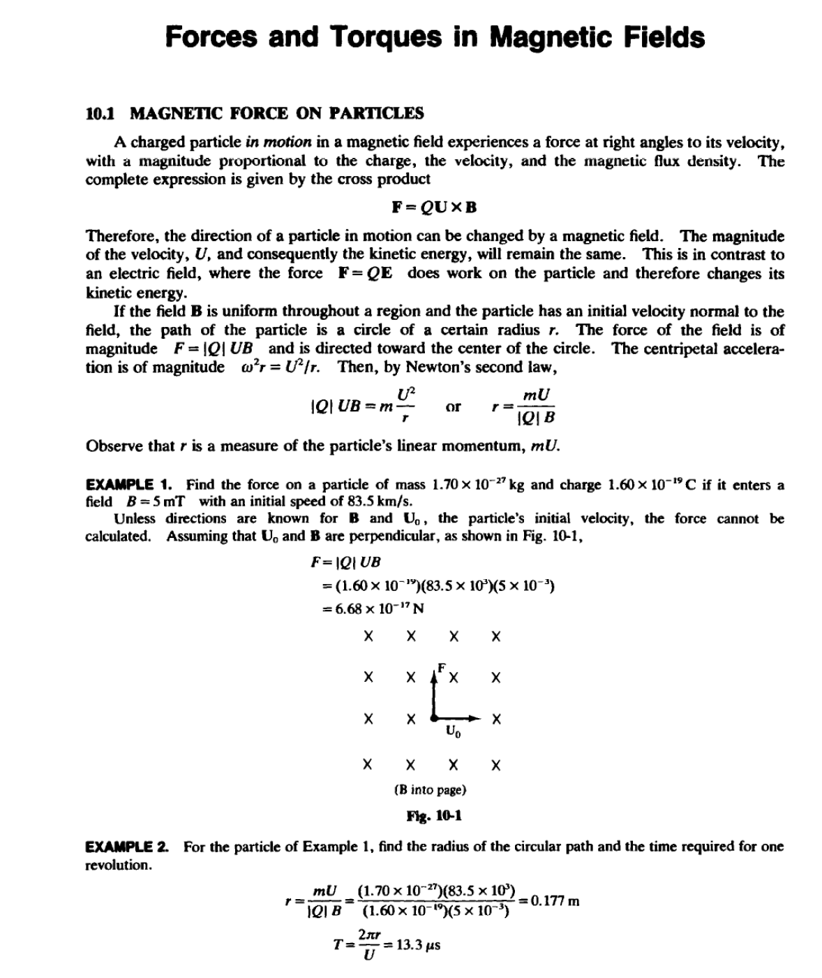
LECTURE 10

Slide 2
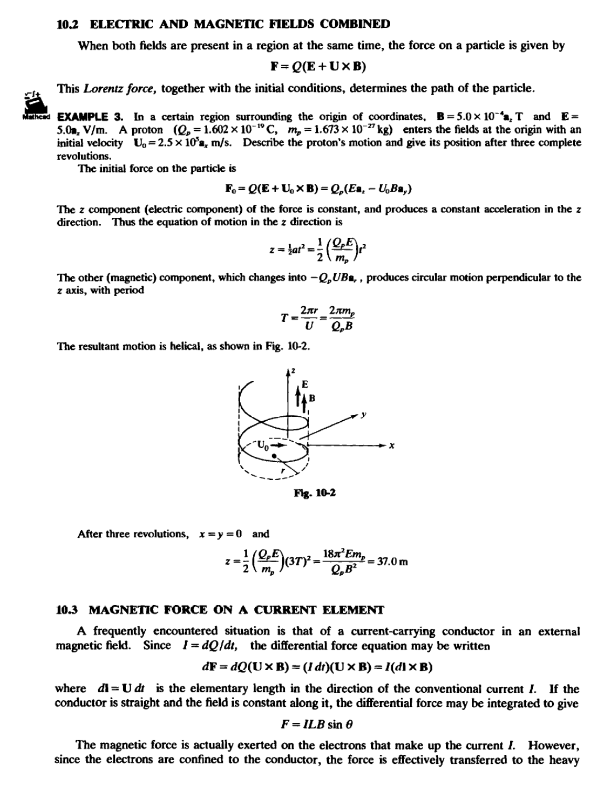
LECTURE 10

Slide 3
LECTURE 10

Slide 4

LECTURE 10
lattice; this transferred force can do work on the conductor as a whole. While this fact provides a reasonable introduction to the behavior of current-carrying conductors in electric machines, certain essential considerations have been omitted. No mention was made, nor will be made in Section 10.4, of the current source and the energy that would be required to maintain a constant current
I. Faraday's law of induction (Section 12.3) was not applied . In electric machine theory the result will be modified by these considerations. Conductors in motion in magnetic fields are treated again in Chapter 12; see particularly Problems 12.10 and 12.13.
EXAMPLE 4. Fmd the force on a straight conductor of length 0.30 m carrying a current of 5.0 A in the -a,
direction , where the field is B =3.50 x 10-³(a.. -ay)T.
F=J(LXB)
•(5.0)((0.30)( -a )X 3.50 X 10-³(a.,. -a,.))
=7.42 x w-,(-a0'ay) N
The force, of magnitude 7.42 mN, is at right angles to both the field 8 and the current direction, as shown in
fig. 10-3.
r
,/ --- ,
:
.... 16-3
10.4 WORK AND POWER
The magnetic forces on the charged particles and current-carrying conductors examined above result from tbe field. To counter these forces and establish equilibrium , equal and opposite forces, F.,, would have to be applied. If motion occurs, the work done on the system by the outside agent applying the force is given by the integral
nail
W =- [ F. ·dl
mitiall
A positive result from the integration indicates that work was done by the agent on the system to move tbe particles or conductor from the initial location to the final, against the field. Because the magnetic force, and hence F.,, is generally nonconservative, the entire path of integration joining the initial and final locations of the conductor must be specified.
EXAMPLE 5. Find the work and power required to move the conductor shown in Fig. l0-4 one full revolution
in the direction shown in 0.02 s, if 8= 2.50 x 10-³a,T and the current is 45.0 A .
F= J(l X B)= 1.13x 10-² N
..
and so F.= -1.13x 10-² N.
..
= f"(-t.13x 10-²)a.·rdtJ>a.
= -2.13 X 10->J
and P <Z W/t = -0.107 W.

Slide 5
LECTURE 10

Slide 6
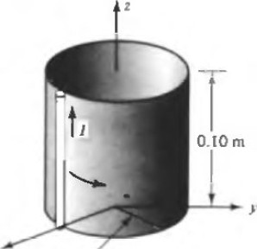

LECTURE 10
X r == 0.03 m
Ytg. 10-4
The negative sign means that work is done by the magnetic field in moving the conductor in the direction shown. For motion in the opposite direction, t.he reversed limits will provide the change of sign, and no attempt to place a sign on r d¢a₄₀ should be made.
  TORQUE
The moment of a force or torque about a specified point is the cross product of the lever arm about that point and the force. The lever ann, r, is directed from the point about which the torque is to be obtained to the point of application of the force. ln Fig. 10-5 the force at P has a torque about 0 given by
T = rXF
where T has the units N ·m. (The units N ·m/rad have been suggested, in order to distinguish torque from energy .)
tz
F
p
y
x
Fig. 16-S
In Fig. 10.5, T lies along an axis (in the xy plane) through 0. If P were joined to 0 by a rigid rod freely pivoted at 0, then the applied force would tend to rotate P about that axis. The torque T would then be said to be about the axis, rather than about point 0.
EXAMPLE 6. A conductor located at x = 0.4 m, y = 0 and 0 <z <2.0 m carries a current of 5.0 A in the a, direction . Along the length of the conductor B = 2.5a,T. Find the torque about the z axis.
F= /(LX 8)= 5.0(2.0a,X 2.5a₆) = 25.0a,. N
T= r x F = 0.4a. X 25.08,. = lO.Oa, N ·m
  MAGNETIC MOMENT OF A PLANAR COIL
Consider the single-turn coil in the z = 0 plane shown in Fig. 10-6, of width w in the x
direction and length f along y. The field 8 is unifonn and in the +x direction. Only the

Slide 7
LECTURE 10

Slide 8
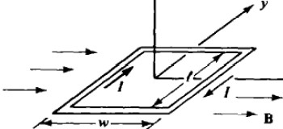
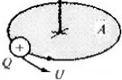
LECTURE 10
z
-
-
fla. 10-6
±y-directcd currents give rise to forces. For the side on the left,
F=- !(l•,. X B•..)= -Bil•.
and for the side on the right,
F-Bil•.
The torque about the y axis from the left current element requires a lever arm r =
-(w/2)8..; the sign will change for the lever arm to the right current element. The torque from both elements is
where A is the area of the coil. It can be shown that this expression for the torque holds for a flat coil of arbitrary shape (and for any axis parallel to they axis).
The magnetic momenl •of a planar current loop is defined as lA•,. , where the unit normal -.. is
determined by the right-hand rule. (The right thumb gives the direction of •, when the fingers point in the direction of the current.) It is seen that the torque on a planar coil is related to the applied field by
T=•X8
This concept of magnetic moment is essential to an understanding of the behavior of orbiting charged partic1es. For example, a positive charge Q moving in a circular orbit at a velocity U, or an angular velocity w, is equivalent to a current I= (w/2n:)Q, and so gives rise to a magnetic moment
w
m=-QA•
2n: "
as sbown in Fig. 10-7. More important to the present discussion is the fact that in the presence of a magnetic field 8 there will be a torque T = m X 8 which tends to tum the current loop until •
and 8 are in the same direction, in which orientation the torque will be zero.
rn
na.to..7

